Slide 1
HW Compute Pool Overview
August 22, 2013
David Stanek

Slide 2
Usage
The compute pool serves a variety of groups
Controller ASIC development team Troy Faber (Rochester) and Steve Provazek (San Jose)
Firmware development team Dan Morcom (Rochester)
Channel architecture team
Channel integration team
FPGA (Pantheon) team
The compute pool provides a number of key services
The base development environment for both ASIC and FPGA teams.
A large number of fast processors for simulations, along with load balancing software.
High performance, redundant storage with backup.
Common code and library repository for global ASIC team.
Shared resource
Computing resources are shared with the firmware team to improve efficiency.
Common storage array, virtual machine hosts, and authentication servers
SLA not defined. Small operation for development; so no official helpdesk and change control process. Japan users are allowed access to run simulations.
Dave provides support during US business hours and occasionally in the evening. Japan users typically contact via email, but support issues are very rare. Japan users can run simulations on local servers if compute pool is unavailable.

Slide 3
Hardware Overview
Notes:
All the Rochester systems reside in the same physical location, which is a controlled access lab space in building 114.
Server hardware and EVA spec’ed by IS&T Infrastructure (B Higginbotham, Greg Pucka)
Bill Foley has visited this space, though not recently.
OS Software is CentOS 6.4, which is basically RHEL6. VM software is KVM, included with CentOS.
RHEL chosen since it is supported by all of our EDA tools (Synopsys, Mentor Graphics, Cadence, Atrenta, etc)

Slide 4
Virtual Servers
Majority of servers are virtualized (RHEL KVM)
License servers lic1, lic2, rfwlic
Documentation & regression system server hemtt, hdcdoc
NFS servers simsrv1, simsrv2
Subversion servers hdcsrv, svn
Windows file share (Samba) servers hostace, rcfiles, simsrv
VNC servers farm40..44
Legacy servers smbfarm, wiki
Virtual servers maintain high performance with added redundancy
High performance shared storage array
Virtual machine hosts have capacity to support many VMs
16 cores, 64 GB RAM, 4 network ports
Ability to migrate VMs to different hardware with minimal downtime.
Support
Dave supports the compute pool with a couple designated backups.
The firmware team has a contract employee (Paul Master) dedicated for their server support, and Dave relies on him for certain tasks, such as dealing with HP and Lenovo hardware support.

Slide 5
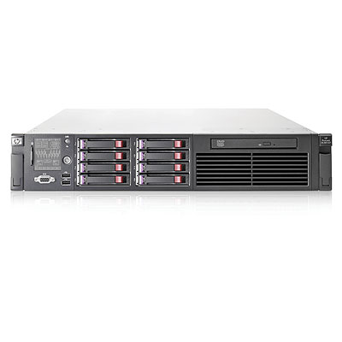
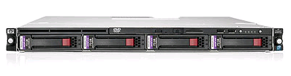
Virtual Machine Hosts (spec’ed by IS&T Infrastructure)
HP DL 385 G7 servers (3)
Highly redundant system
64GB RAM
Dual AMD 6220 processors (8 cores each)
Dual-port FC HBA
Dual power supplies
Dual HDDs (RAID-1) for OS
4 network ports
HP DL 360 G7 server (1)
Highly redundant system
72GB RAM
Dual Intel X5672 processors (4 cores each)
Dual-port FC HBA
Dual power supplies
Dual HDDs (RAID-1) for OS
4 network ports

Slide 6
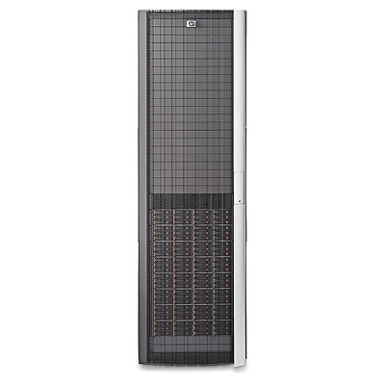
Storage Array (spec’ed by IS&T Infrastructure)
HP EVA 4400
Management module, dual controllers, dual FC switches
5 drive trays installed.
5.5 TB available storage per drive tray
High performance, Fibre Channel storage solution
HGST IT standard
planning to migrate data off this unit by 2014
HP 3PAR 7200
New storage array shared with IS&T, firmware, and hardware teams
Approx 15TB available storage per drive tray.
Still working on getting the unit setup.

Slide 7
Simulation Servers
HP DL 360p Gen8 servers (18)
128GB RAM
Dual Xeon E5-2643 (3.3 GHz Sandy Bridge) processors (4 cores each)
1U
HP DL 360 G7 servers (3)
144GB RAM
Dual Intel X5672 (3.2 GHz Nehalem) processors (4 cores each)
1U
Lenovo D20 servers (10)
32GB RAM
Dual Intel W5580 (3.2 GHz Nehalem) processors (4 cores each)
Total cores available: 248

Slide 8
Backup Strategy
Rochester site has access to an IGS managed backup solution
TSM: Tivoli Storage Manager
Automated backup for all systems: servers, desktops, laptops
Located in a separate building on site
Controller strategy
File servers utilize several layers of protection against data loss and downtime
RAID storage in case of drive failure
Redundant servers in case of system failure
Tape backup in case of unforeseen failure or accidental data loss
Tape backups occur nightly
San Jose server data is mirrored onto a Rochester server, then backed up to tape.

Slide 9
Power Loss Mitigation
Storage array and virtual machine hosts are protected against power loss
APC Smart-UPS – 4kW / 5000 VA unit protecting the rack
Approximately 15 minutes of runtime at load
Machines are notified when less than 5 minutes of runtime remain to perform orderly shutdown.
Simulation servers are not protected
Protection is not required.
No data is stored on simulation servers. Simulations can be rerun if needed.

Slide 10
San Jose Controller Team – Steve Provazek
Controller ASIC development team in San Jose
Utilizes much of the computing resource in Rochester via WAN
Small amount of local hardware to improve response time for interactive simulations
Critical common data is mirrored to San Jose fileserver daily (tools, library data)
San Jose user data is mirrored back to Rochester daily for backup

